Slide 1

Analysis & Design of Algorithms
Chained Matrix Multiplication Problem
Prepared by:-
Sagar Virani
Assistant Professor
Computer Engineering Department
VVP Engineering College

Slide 2

Chained Matrix Multiplication Problem
Let A be a p x q and B be a q x r matrix.
The product C = A x B will result in a p x r matrix.
$A=\left[\begin{matrix}a_{11} & a_{12} & … & a_{1q} \\ a_{21} & a_{22} & … & a_{2q} \\ . & & & \\ . & & & \\ a_{p1} & a_{p2} & … & a_{pq}\end{matrix}\right]$ $B=\left[\begin{matrix}b_{11} & a_{12} & … & a_{1r} \\ b_{21} & a_{22} & … & a_{2r} \\ . & & & \\ . & & & \\ b_{q1} & b_{q2} & … & b_{qr}\end{matrix}\right]$ $C=\left[\begin{matrix}c_{11} & c_{12} & … & c_{1r} \\ c_{21} & c_{22} & … & c_{2r} \\ . & & & \\ . & & & \\ c_{p1} & c_{p2} & … & c_{pr}\end{matrix}\right]$
To multiply A with B we require a total of p x q x r scalar multiplications.

Slide 3
Chained Matrix Multiplication Problem
Suppose we want to calculate the product of more than two matrices.
You are given:
A set of matrices {M₁, M₂, M₃,…, M _{n}}.
To calculate: The product of all the given matrices.
M = M₁ M₂ M₃ … M_{n}
Matrix multiplication is associative (we can perform the multiplication in multiple ways by putting appropriate brackets) but not commutative (we cannot change the order).
We will get the same answers in a number of ways:
M = (… ((M₁ M₂)M₃)… M _{n})
= (M₁ (M₂ (M₃ … (M_{n – 1} M_{n}) … )))
= ( … ((M₁ M₂) (M₃ M₄))… )
and so on.

Slide 4
Chained Matrix Multiplication Problem
Example:
We want to calculate the product of 4 matrices A, B, C, D given below.
A is 13 x 5
B is 5 x 89
C is 89 x 3
D is 3 x 34.
To measure the efficiency of the different methods, we count the number of scalar multiplications involved.
There will be an equal number of scalar additions, plus some housekeeping operations so the number of scalar multiplications is a good indicator of overall efficiency.

Slide 5
Chained Matrix Multiplication Problem
Example:
A is 13 x 5
B is 5 x 89
C is 89 x 3
D is 3 x 34.
M Scalar Multiplications Total
((A B) C) D (A B) = 5785, (A B) C = 3471, ((A B) C) D = 1326 10582
(A B)(C D) (A B) = 5785, (C D) = 9078, (A B)(C D) = 39338 54201
(A (B C)) D (B C) = 1335, (A (B C) = 195, (A (B C)) D) = 1326 2856
A ((B C) D) (B C) = 1335, ((B C) D) = 510, A ((B C) D) = 2210 4055
A (B (C D)) (C D) = 9078, (B (C D)) = 15130, A (B (C D)) = 2210 26418

Slide 6
Chained Matrix Multiplication Problem
Example:
A is 13 x 5
B is 5 x 89
C is 89 x 3
D is 3 x 34.
M Scalar Multiplications Total
((A B) C) D (A B) = 5785, (A B) C = 3471, ((A B) C) D = 1326 10582
(A B)(C D) (A B) = 5785, (C D) = 9078, (A B)(C D) = 39338 54201
(A (B C)) D (B C) = 1335, (A (B C) = 195, (A (B C)) D) = 1326 2856
A ((B C) D) (B C) = 1335, ((B C) D) = 510, A ((B C) D) = 2210 4055
A (B (C D)) (C D) = 9078, (B (C D)) = 15130, A (B (C D)) = 2210 26418
Most efficient method is almost 19 times faster than the slowest.

Slide 7
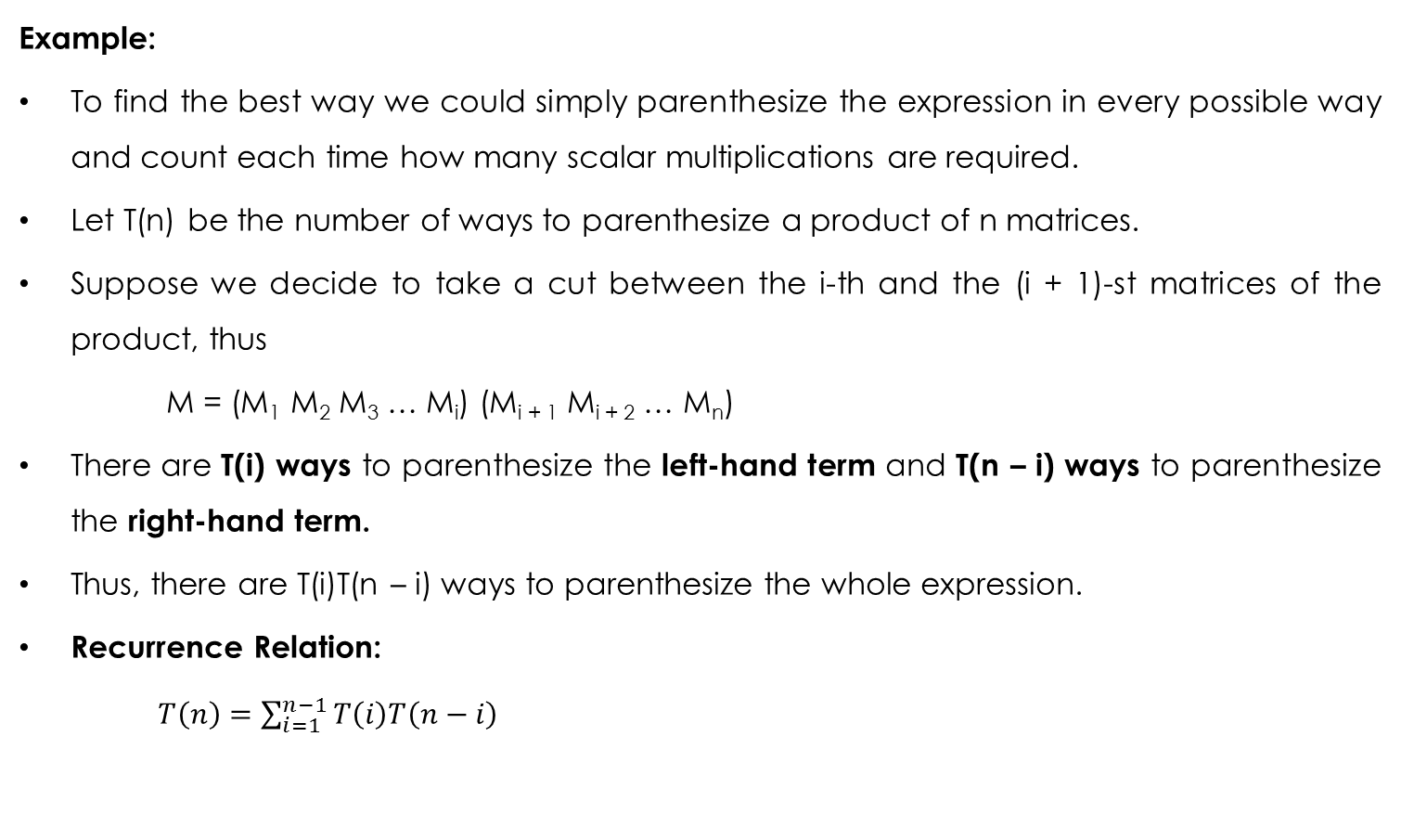
Chained Matrix Multiplication Problem
Example:
To find the best way we could simply parenthesize the expression in every possible way and count each time how many scalar multiplications are required.
Let T(n) be the number of ways to parenthesize a product of n matrices.
Suppose we decide to take a cut between the i-th and the (i + 1)-st matrices of the product, thus
M = (M₁ M₂ M₃ … M_{i}) (M_{i + 1} M_{i + 2} … M_{n})
There are T(i) ways to parenthesize the left-hand term and T(n – i) ways to parenthesize the right-hand term.
Thus, there are T(i)T(n – i) ways to parenthesize the whole expression.
Recurrence Relation:
$T\left(n\right)=\sum_{i=1}^{n−1}{T\left(i\right)T\left(n−i\right)}$

Slide 8

Chained Matrix Multiplication Problem
Example:
Solution of the Recurrence Relation:
$T\left(n\right)=\sum_{i=1}^{n−1}{T\left(i\right)T\left(n−i\right)}$ = Ω(4^{n} / n² ).
n 1 2 3 4 10 15
T(n) 1 1 3 5 4862 2674440
The values of T(n) are called Catalan numbers.
This method is impractical for large values of n.

Slide 9
Chained Matrix Multiplication Problem
If the best way of multiplying all the matrices requires to make the first cut between the i-th and the (i + 1)-st matrices of the product, then both the sub products (M₁ M₂ M₃ … M_{i}) and (M_{i + 1} M_{i + 2} … M_{n}) must also be calculated in optimal way.
Thus, principle of optimality applies to this problem.

Slide 10
Chained Matrix Multiplication Problem
We construct a table m_{ij} where m_{ij} give the optimal solution – that is, required number of scalar multiplications – for the part (M_{i} M_{i + 1} … M_{j}) of the required product.
The solution of the original problem is thus given by m_{1n}.
We build the table diagonal by diagonal.

Slide 11
Chained Matrix Multiplication Problem
Example:
A is 13 x 5
B is 5 x 89
C is 89 x 3
D is 3 x 34.
s = 0 : m_{i, i} = 0.
m_{AA} = m_{BB} = m_{CC} = m_{DD} = 0 0
A
B
C
D
A
0
B
0
C
0
D
0
s = 0

Slide 12
Chained Matrix Multiplication Problem
Example:
A is 13 x 5
B is 5 x 89
C is 89 x 3
D is 3 x 34.
s = 1 : m_{i, i + 1} = p_{i – 1} p_{i} p_{i + 1}.
m_{AB} = 13 x 5 x 89
= 5785
A
B
C
D
A
0
5785
B
0
C
0
s = 1
D
0
s = 0

Slide 13
Chained Matrix Multiplication Problem
Example:
A is 13 x 5
B is 5 x 89
C is 89 x 3
D is 3 x 34.
s = 1 : m_{i, i + 1} = p_{i – 1} p_{i} p_{i + 1}.
m_{AB} = 13 x 5 x 89
= 5785
m_{BC} = 5 x 89 x 3
= 1335
A
B
C
D
A
0
5785
B
0
1335
C
0
s = 1
D
0
s = 0

Slide 14
Chained Matrix Multiplication Problem
Example:
A is 13 x 5
B is 5 x 89
C is 89 x 3
D is 3 x 34.
s = 1 : m_{i, i + 1} = p_{i – 1} p_{i} p_{i + 1}.
m_{AB} = 13 x 5 x 89
= 5785
m_{BC} = 5 x 89 x 3
= 1335
m_{CD} = 89 x 3 x 34
= 9078
A
B
C
D
A
0
5785
B
0
1335
C
0
9078
s = 1
D
0
s = 0

Slide 15
Chained Matrix Multiplication Problem
Example:
A is 13 x 5
B is 5 x 89
C is 89 x 3
D is 3 x 34.
s > 1 : min(m_{ik} + m_{k + 1, i + s} + p_{i – 1} p_{k} p_{i + s}.
m_{AC} = min (m_{AA} + m_{BC} + 13 x 5 x 3, m_{AB} + m_{CC} + 13 x 89 x 3)
= min (0 + 1335 + 195, 5785 + 0 + 3471)
= min (1530, 9256) = 1530
A
B
C
D
A
0
5785
1530
B
0
1335
s = 2
C
0
9078
s = 1
D
0
s = 0

Slide 16
Chained Matrix Multiplication Problem
Example:
A is 13 x 5
B is 5 x 89
C is 89 x 3
D is 3 x 34.
s > 1 : min(m_{ik} + m_{k + 1, i + s} + p_{i – 1} p_{k} p_{i + s}.
m_{AC} = min (m_{AA} + m_{BC} + 13 x 5 x 3, m_{AB} + m_{CC} + 13 x 89 x 3)
= min (0 + 1335 + 195, 5785 + 0 + 3471)
= min (1530, 9256) = 1530
m_{BD} = min (m_{BB} + m_{CD} + 5 x 89 x 34, m_{BC} + m_{DD} + 5 x 3 x 34)
= min (0 + 9078 + 15130, 1335 + 0 + 510)
= min (24208, 1845) = 1845
A
B
C
D
A
0
5785
1530
B
0
1335
1845
s = 2
C
0
9078
s = 1
D
0
s = 0

Slide 17
Chained Matrix Multiplication Problem
Example:
A is 13 x 5
B is 5 x 89
C is 89 x 3
D is 3 x 34.
s > 1 : min(m_{ik} + m_{k + 1, i + s} + p_{i – 1} p_{k} p_{i + s}.
m_{AD} = min(m_{AA} + m_{BD} + 13 x 5 x 34, m_{AB} + m_{CD} + 13 x 89 x 34, m_{AC} + m_{DD} + 13 x 3 x 34)
= min (0 + 1845 + 2210, 5785 + 9078 + 39338, 1530 + 0 + 1326 )
= min (4055, 54201, 2856) = 2856
So minimum scalar multiplications required for the given problem = 2856.
A
B
C
D
A
0
5785
1530
2856
s = 3
B
0
1335
1845
s = 2
C
0
9078
s = 1
D
0
s = 0

Slide 18
Chained Matrix Multiplication Problem
Do it yourself:
D = [30, 35, 15, 5, 10, 20, 25].
A1 is 30 x 35
A2 is 35 x 15
A3 is 15 x 5
A4 is 5 x 10
A5 is 10 x 20
A6 is 20 x 25.
A1
A2
A3
A4
A5
A6
A1
0
15750
7875
9375
11875
15125
s = 5
A2
0
2625
4375
7125
10500
s = 4
A3
0
750
2500
5375
s = 3
A4
0
1000
3500
s = 2
A5
0
5000
s = 1
A6
0
s = 0

Slide 19
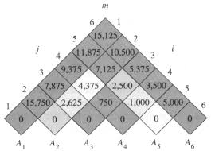
Chained Matrix Multiplication Problem
Do it yourself:
D = [30, 35, 15, 5, 10, 20, 25].
A1 is 30 x 35
A2 is 35 x 15
A3 is 15 x 5
A4 is 5 x 10
A5 is 10 x 20
A6 is 20 x 25.

Slide 20
Chained Matrix Multiplication Problem
Example:
A is 13 x 5
B is 5 x 89
C is 89 x 3
D is 3 x 34.
s = 0 : m_{ii} = 0.
m_{AA} = m_{BB} = m_{CC} = m_{DD} = 0 0
A
B
C
D
B
C
D
0
A
A
B
0
B
C
0
C
D
0
s = 0

Slide 21
Chained Matrix Multiplication Problem
Example:
A is 13 x 5
B is 5 x 89
C is 89 x 3
D is 3 x 34.
s = 1 : m_{i, i + 1} = d_{i – 1} d_{i} d_{i + 1}.
m_{AB} = 13 x 5 x 89
= 5785
A
B
C
D
B
C
D
0
5785
A
A
A
B
0
B
C
0
C
s = 1
s = 1
D
0
s = 0

Slide 22
Chained Matrix Multiplication Problem
Example:
A is 13 x 5
B is 5 x 89
C is 89 x 3
D is 3 x 34.
s = 1 : m_{i, i + 1} = d_{i – 1} d_{i} d_{i + 1}.
m_{AB} = 13 x 5 x 89
= 5785
m_{BC} = 5 x 89 x 3
= 1335
A
B
C
D
B
C
D
0
5785
A
A
A
B
0
1335
B
B
C
0
C
s = 1
s = 1
D
0
s = 0

Slide 23
Chained Matrix Multiplication Problem
Example:
A is 13 x 5
B is 5 x 89
C is 89 x 3
D is 3 x 34.
s = 1 : m_{i, i + 1} = d_{i – 1} d_{i} d_{i + 1}.
m_{AB} = 13 x 5 x 89
= 5785
m_{BC} = 5 x 89 x 3
= 1335
m_{CD} = 89 x 3 x 34
= 9078
A
B
C
D
B
C
D
0
5785
A
A
A
B
0
1335
B
B
C
0
9078
C
C
s = 1
s = 1
D
0
s = 0

Slide 24
Chained Matrix Multiplication Problem
Example:
A is 13 x 5
B is 5 x 89
C is 89 x 3
D is 3 x 34.
s > 1 : min(m_{ik} + m_{k + 1, i + s} + d_{i – 1} d_{k} d_{i + s}.
m_{AC} = min (m_{AA} + m_{BC} + 13 x 5 x 3, m_{AB} + m_{CC} + 13 x 89 x 3)
= min (0 + 1335 + 195, 5785 + 0 + 3471)
= min (1530, 9256) = 1530
A
B
C
D
B
C
D
0
5785
1530
A
A
A
A
B
0
1335
B
B
s = 2
s = 2
C
0
9078
C
C
s = 1
s = 1
D
0
s = 0

Slide 25
Chained Matrix Multiplication Problem
Example:
A is 13 x 5
B is 5 x 89
C is 89 x 3
D is 3 x 34.
s > 1 : min(m_{ik} + m_{k + 1, i + s} + d_{i – 1} d_{k} d_{i + s}.
m_{AC} = min (m_{AA} + m_{BC} + 13 x 5 x 3, m_{AB} + m_{CC} + 13 x 89 x 3)
= min (0 + 1335 + 195, 5785 + 0 + 3471)
= min (1530, 9256) = 1530
m_{BD} = min (m_{BB} + m_{CD} + 5 x 89 x 34, m_{BC} + m_{DD} + 5 x 3 x 34)
= min (0 + 9078 + 15130, 1335 + 0 + 510)
= min (24208, 1845) = 1845
A
B
C
D
B
C
D
0
5785
1530
A
A
A
A
B
0
1335
1845
B
B
C
s = 2
s = 2
C
0
9078
C
C
s = 1
s = 1
D
0
s = 0

Slide 26
Chained Matrix Multiplication Problem
Example:
A is 13 x 5
B is 5 x 89
C is 89 x 3
D is 3 x 34.
s > 1 : min(m_{ik} + m_{k + 1, i + s} + d_{i – 1} d_{k} d_{i + s}.
m_{AD} = min(m_{AA} + m_{BD} + 13 x 5 x 34, m_{AB} + m_{CD} + 13 x 89 x 34, m_{AC} + m_{DD} + 13 x 3 x 34)
= min (0 + 1845 + 2210, 5785 + 9078 + 39338, 1530 + 0 + 1326 )
= min (4055, 54201, 2856) = 2856
A
B
C
D
B
C
D
0
5785
1530
A
A
2856
A
A
C
s = 3
s = 3
B
0
1335
1845
B
B
C
s = 2
s = 2
C
0
9078
C
C
s = 1
s = 1
D
0
s = 0

Slide 27
Chained Matrix Multiplication Problem
Example:
For optimal parenthesization:
A B C | D
Parenthesization is:
( A B C ) D
B
C
D
A
A
A
C
s = 3
B
B
C
s = 2
C
C
s = 1

Slide 28
Chained Matrix Multiplication Problem
Example:
For optimal parenthesization:
A | B C | D
Parenthesization is:
( A ( B C ) ) D .
B
C
D
A
A
A
C
s = 3
B
B
C
s = 2
C
C
s = 1

Slide 29
Chained Matrix Multiplication Problem
Example:
For optimal parenthesization:
A | B C | D
Therefore, the optimal parenthesization is:
( A ( B C ) ) D.
B
C
D
A
A
A
C
s = 3
B
B
C
s = 2
C
C
s = 1

Slide 30
Chained Matrix Multiplication Problem
Do it yourself:
D = [30, 35, 15, 5, 10, 20, 25].
A1
A2
A3
A4
A5
A6
A2
A3
A4
A5
A6
A1
0
15750
7875
9375
11875
15125
s = 5
A1
1
1
3
3
3
s = 5
A2
0
2625
4375
7125
10500
A2
2
3
3
3
s = 4
s = 4
A3
0
750
2500
5375
A3
3
3
3
s = 3
s = 3
A4
0
1000
3500
A4
4
5
s = 2
s = 2
A5
0
5000
A5
5
s = 1
s = 1
A6
0
s = 0

Slide 31
Chained Matrix Multiplication Problem
Do it yourself:
D = [30, 35, 15, 5, 10, 20, 25].
A₁ A₂ A₃ | A₄ A₅ A₆
Parenthesization is:
( A₁ A₂ A₃ ) ( A₄ A₅ A₆ ).
A2
A3
A4
A5
A6
A1
1
1
3
3
3
s = 5
A2
2
3
3
3
s = 4
A3
3
3
3
s = 3
A4
4
5
s = 2
A5
5
s = 1

Slide 32
Chained Matrix Multiplication Problem
Do it yourself:
D = [30, 35, 15, 5, 10, 20, 25].
A₁ | A₂ A₃ | A₄ A₅ A₆
Parenthesization is:
( ( A₁ ( A₂ A₃ ) ) ( A₄ A₅ A₆ ).
A2
A3
A4
A5
A6
A1
1
1
3
3
3
s = 5
A2
2
3
3
3
s = 4
A3
3
3
3
s = 3
A4
4
5
s = 2
A5
5
s = 1

Slide 33
Chained Matrix Multiplication Problem
Do it yourself:
D = [30, 35, 15, 5, 10, 20, 25].
A₁ | A₂ A₃ | A₄ A₅ | A₆
Parenthesization is:
( ( A₁ ( A₂ A₃ ) ) ( ( A₄ A₅ ) A₆ ) ).
A2
A3
A4
A5
A6
A1
1
1
3
3
3
s = 5
A2
2
3
3
3
s = 4
A3
3
3
3
s = 3
A4
4
5
s = 2
A5
5
s = 1

Slide 34
Chained Matrix Multiplication Problem
Do it yourself:
D = [30, 35, 15, 5, 10, 20, 25].
A₁ | A₂ A₃ | A₄ A₅ | A₆
Therefore, optimal parenthesization is:
( ( A₁ ( A₂ A₃ ) ) ( ( A₄ A₅ ) A₆ ) ).
A2
A3
A4
A5
A6
A1
1
1
3
3
3
s = 5
A2
2
3
3
3
s = 4
A3
3
3
3
s = 3
A4
4
5
s = 2
A5
5
s = 1

Slide 35
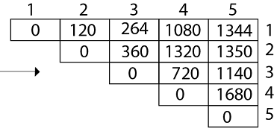
Chained Matrix Multiplication Problem
Do it yourself:
D = [4, 10, 3, 12, 20, and 7].

Slide 36
Chained Matrix Multiplication Problem
Algorithm: MATRIX-CHAIN-ORDER (p)
n = p.length – 1
let m[ 1 … n, 1 … n ] and s[ 1 … n – 1, 2 … n ] be new tables
for i = 1 to n do
m[ i, i ] = 0
for l = 2 to n do
for i = 1 to n – l + 1 do
j = i + l – 1
m[ i, j ] = ∞
for k = i to j – 1 do
q = m[ i, k ] + m[ k + 1, j ] + p_{i – 1} p_{k} p_{j}
if q < m[ i, j ] then
m[ i, j ] = q
s[ i, j ] = k
return m and s

Slide 37
Chained Matrix Multiplication Problem
Algorithm: MATRIX-CHAIN-ORDER (p)
n = p.length – 1
let m[ 1 … n, 1 … n ] and s[ 1 … n – 1, 2 … n ] be new tables
for i = 1 to n do
m[ i, i ] = 0
for l = 2 to n do
for i = 1 to n – l + 1 do
j = i + l – 1
m[ i, j ] = ∞
for k = i to j – 1 do
q = m[ i, k ] + m[ k + 1, j ] + p_{i – 1} p_{k} p_{j}
if q < m[ i, j ] then
m[ i, j ] = q
s[ i, j ] = k
return m and s
Analysis:
Initialization takes Ө(n).

Slide 38
Chained Matrix Multiplication Problem
Algorithm: MATRIX-CHAIN-ORDER (p)
n = p.length – 1
let m[ 1 … n, 1 … n ] and s[ 1 … n – 1, 2 … n ] be new tables
for i = 1 to n do
m[ i, i ] = 0
for l = 2 to n do
for i = 1 to n – l + 1 do
j = i + l – 1
m[ i, j ] = ∞
for k = i to j – 1 do
q = m[ i, k ] + m[ k + 1, j ] + p_{i – 1} p_{k} p_{j}
if q < m[ i, j ] then
m[ i, j ] = q
s[ i, j ] = k
return m and s
Analysis:
Initialization takes Ө(n).
The loops are nested three deep, and each loop index (l, i and k) takes on at most n – 1 values.
Therefore, the running time of the algorithm is Ө(n³).

Slide 39
Any Questions?

